Slide 1
NOJ season 4
Fang Wang

Slide 2
season 4
The array
Sum two arrays
Left upper corner
The upper right corner
The lower left corner
The lower right corner
5X5 array
Edge and inner
1:2:3
Division

Slide 3
How to write a program?
Get rooms
Step 1: declare variables
Step 2: input data
Step 3: calculate
Step 4: output
Store data
calculate
print the result

Slide 4
The array
So far, the variables we’ve seen are capable of holding a single data item.
C also supports aggregate variables, which can store collections of values.
arrays
Notes:
So far, the variables we’ve seen are capable of holding a single data item.
目前为止我们所学的变量都是用来存储一个数据的。
C also supports aggregate [ˈæɡrɪɡeɪt] variables, which can store collections of values.
C也支持集合，集合可以用来存放一批数据
arrays

Slide 5
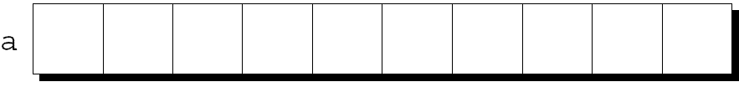
  Arrays let us store a set of data
  An array is a data structure containing a number of data values, all of which have the same type.
  These values, known as elements, can be individually selected by their position within the array.
  The elements of a one-dimensional array a are arranged one after another in a single row (or column):
Notes:
Arrays let us store a set of data 数据可用来存储一组数据
An array is a data structure containing a number of data values, all of which have the same type.
数组包含一组变量，这些变量类型相同
These values, known as elements, can be individually selected by their position within the array.
这些变量叫做数组元素
The elements of a one-dimensional array a are arranged one after another in a single row (or column):一维数组所有元素在内存中连续排列，占据连续的内存空间

Slide 6
Array Variable Declaration
a[0]
a[1]
.
.
.
a[9]
int a [10]
the type of the array’s
elements
name
the number
of elements
Notes:
To declare an array, we must specify the type of the array’s elements and the number of elements:
int a[10];
The length of the array can be any (integer) constant expression.
In simple words, we declare 10 variables (array elements) from a[0]( 方括号square brackets) to a[9], and they occupy continuous memory .

Slide 7
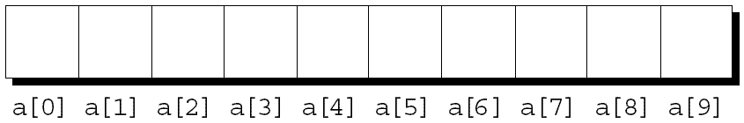
Array Subscripting
  How to access an array element?
  The elements of an array of length n are indexed from 0 to n – 1.
  If a is an array of length 10, its elements are designated by a[0], a[1], …, a[9]:
Notes:
How to access an array element?
The elements of an array of length n are indexed from 0 to n – 1.
If a is an array of length 10, its elements are designated[ˈdezɪɡneɪtɪd] by a[0], a[1], …, a[9]:
The square brackets [ ] enclose their position within the array.
The position is the subscript of those array elements.

Slide 8
Array Subscripting
  Expressions of the form a[i] can be used in the same way as ordinary variables:
a[0] = 1;
printf("%d\n", a[5]);
/* the subscript can be any integer expression */
Notes:
Array Subscripting
Expressions of the form a[i] can be used in the same way as ordinary variables:
数组元素可以像普通变量一样用
a[0] = 1;
printf("%d\n", a[5]);
/* the subscript can be any integer expression */

Slide 9
Array Subscripting
  Many programs contain for loops whose job is to perform some operation on every element in an array.
  Examples of typical operations on an array a of length N:
  IDIOM
for (i = 0; i < N; i++)
scanf("%d", &a[i]); // reads data into a
for (i = 0; i < N; i++)
printf("%d", a[i]); // display the elements of a
for (i = 0; i < N; i++)
sum += a[i]; // sums the elements of a
Notes:
Many programs contain for loops whose job is to perform some operation on every element in an array.
Examples of typical operations on an array a of length N:
惯用法 IDIOM [ˈɪdiəm]
for (i = 0; i < N; i++)
scanf("%d", &a[i]); /* reads n data from the keyboards and then stored them into the array a . The first number is stored int a[0], the second is stored into a[1]…..
for (i = 0; i < N; i++)
printf("%d", &a[i]); // display the elements of a
for (i = 0; i < N; i++)
sum += a[i]; /* sums all the elements of the array a */

Slide 10
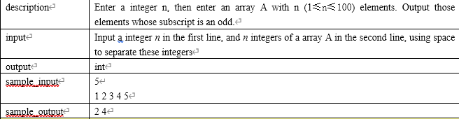
The array

Slide 11
int n,i;
scanf("%d",&n);
int A[n];
for(i=0;i<n;i++) scanf("%d",&A[i]);
for(i=1;i<n;i+=2)
printf("%d ",A[i]);
Notes:
Because we must type in n, so we should declare n . We will use for loop, , so we should declare i .
The input description says n is an integer , so we declare int n and i. The question asks the user to enter n, so we call function scanf .
And because n is int, so we use %d for int type. scanf("%d",&n);
The question asks the user to enter an array with n elements. So we should declare int A[n];
Then we use the惯用法 IDIOM [ˈɪdiəm] to reads data into a
for (i = 0; i < N; i++) scanf("%d", &a[i]);
The question asks the user to Output those elements whose subscript is an odd[ɑːd] . So we modify the IDIOM [ˈɪdiəm] for loop as
for(i=1;i<n;i+=2) printf("%d ",A[i]); so we will skip a[0] and display a[1], then skip a[2], and display a[3], and so on…

Slide 12
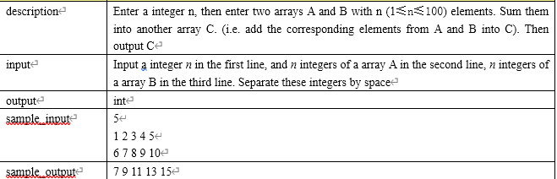
Sum two arrays

Slide 13
int n,i;
scanf("%d",&n);
int A[n],B[n],C[n];
for(i=0;i<n;i++) scanf("%d",&A[i]);
for(i=0;i<n;i++) scanf("%d",&B[i]);
for(i=0;i<n;i++) C[i]=A[i]+B[i];
for(i=0;i<n;i++)
printf("%d ",C[i]);
Notes:
Because we must type in n, so we should declare n first. And We will use for loop, , so we should declare i .
The input description tells us n is an integer , so we declare int n and i. The question asks the user to enter n, so we call function scanf .
And because n is int, so we use %d for int type. scanf("%d",&n);
Now we can use n declare the arrays ABC. int A[n],B[n],C[n]; n enclosed in the square brackets means the arrays has n elements.
Then we use the惯用法 IDIOM [ˈɪdiəm] to reads data into a and b.
for(i=0;i<n;i++) scanf("%d",&A[i]);for(i=0;i<n;i++) scanf("%d",&B[i]);
Then we should add the corresponding elements from A and B into C). So we use a for loop to perform addition on every element in arrays a and b
for(i=0;i<n;i++) C[i]=A[i]+B[i]; it means, add a[0] and b[0], then put to result to c[0]. add a[1] and b[1], then put to result to c[1]. …
Now we can display C. for(i=0;i<n;i++) printf("%d ",C[i]);

Slide 14
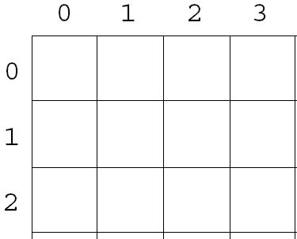
two-dimensional Arrays
The following declaration creates a two-dimensional array
int a[3][4];
a has 3 rows and 4 columns. Both rows and columns are indexed from 0:
Notes:
An array may have any number of dimensions.
The following declaration creates a two-dimensional array (a matrix, in mathematical terminology):
int a[3][4];
a has 3 rows and 4 columns. Both rows and columns [ˈkɑləmz] are indexed from 0:

Slide 15
int a[3][4];
Column 0 1 2 3
row 0
row 1
row 2
a[0][0] | a[0][1] | a[0][2] | a[0][3]
a[1][0] | a[1][1] | a[1][2] | a[1][3]
a[2][0] | a[2][1] | a[2][2] | a[2][3]
To access the element of a in row i, column j, we must write a[i][j].

Slide 16
---------a[0][0] a[0][1] a[0][2]
a[2][3]
---------a[1][0] a[1][1] a[1][2]
low 0
low 1
a[0][0]
a[0][1]
a[0][2]
a[1][0]
a[1][1]
a[1][2]
Notes:
Although we visualize [ˈvɪʒuəlaɪz] two-dimensional arrays as tables, that’s not the way they’re actually stored in computer memory.
C stores arrays in row-major order, with row 0 first, then row 1, and so on.
This photo shows How the a[2][3] array is stored:

Slide 17
Nested for loops are ideal for processing multidimensional arrays.
for (row = 0; row < N; row++)
for (col = 0; col < N; col++)
……………………..
for (i = 0; i < 5; i++)
for (j = 0; j < 5; j++)
scanf(“%d”,&a[i][j]);
Notes:
A pair of Nested for loops are ideal for processing multidimensional arrays.
//Consider the problem of initializing an array for use as an identity matrix. A pair of nested for loops is perfect通常用两重循环（循环嵌套） 来处理二维数组
for (row = 0; row < N; row++)
for (col = 0; col < N; col++)
……………………..
for (i = 0; i < 5; i++)
for (j = 0; j < 5; j++)
scanf(“%d”,&a[i][j]);

Slide 18
Exercise
  Ask the user to input a two dimensional array (NXN), then output the elements in the secondary diagonal.次对角线

Slide 19
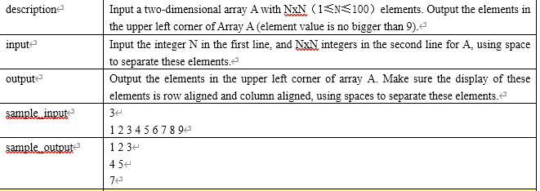
Left upper corner

Slide 20

int n,i,j;
scanf("%d",&n);
int a[n][n];
for(i=0;i<n;i++)
  for(j=0;j<n;j++)
  scanf("%d",&a[i][j]);
for(i=0;i<n;i++){
for(j=0;j<n;j++){
printf("%d ",a[i][j]);
if(j+i==n-1) break; }
printf("\n");
}
Notes:
Because we must type in n, so we should declare n first. And We will use for loop, , so we should declare i ,j .
The input description tells us n is an integer , so we declare int n ,i and j. The question asks the user to enter n, so we call function scanf .
And because n is int, so we use %d for int type. scanf("%d",&n);
Now we can use n declare the 2D array A . int A[n][n]; n enclosed in the square brackets means the arrays has n rows n cols elements.
Then we use a pair of Nested for loops to reads data into a for(i=0;i<n;i++) for(j=0;j<n;j++) scanf("%d",&a[i][j]);
Then we use a pair of Nested for loops to display a for(i=0;i<n;i++){ for(j=0;j<n;j++){ printf("%d ",a[i][j]);
because we should output the elements at the left side of the secondary diagonal. Let’s see all the elements in the the secondary diagonal
The sum of the row and col is n. So if(j+i==n-1) we should stop display this line. So we break; } after diasplay one line , printf("\n");

Slide 21
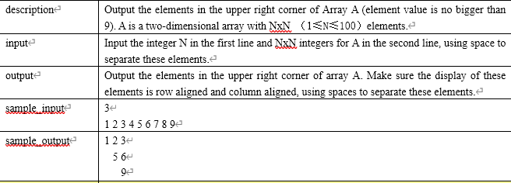
The upper right corner

Slide 22
int n,i,j;
scanf("%d",&n);
int a[n][n];
for(i=0;i<n;i++)
for(j=0;j<n;j++)
scanf("%d",&a[i][j]);
for(i=0;i<n;i++){
for(j=0;j<n;j++)
if(i>j) printf(" ");
else printf("%d ",a[i][j]);
printf("\n");
}

Slide 23
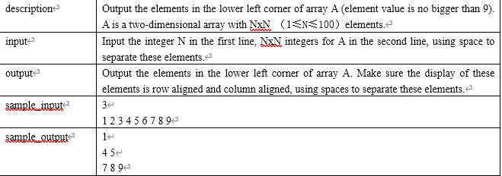
The lower left corner

Slide 24
int n,i,j;
scanf("%d",&n);
int a[n][n];
for(i=0;i<n;i++)
for(j=0;j<n;j++)
scanf("%d",&a[i][j]);
for(i=0;i<n;i++){
for(j=0;j<n;j++)
if(i>=j) printf("%d ",a[i][j]);
printf("\n");
}

Slide 25
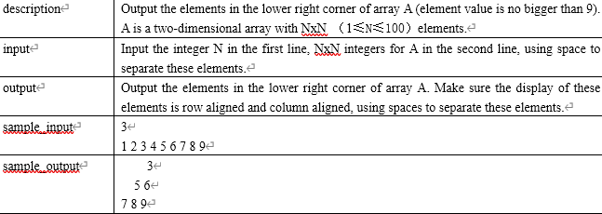
The lower right corner

Slide 26
int n,i,j;
scanf("%d",&n);
int a[n][n];
for(i=0;i<n;i++)
for(j=0;j<n;j++)
scanf("%d",&a[i][j]);
for(i=0;i<n;i++){
for(j=0;j<n;j++)
if(i+j>=n-1)printf("%d ",a[i][j]);
else printf(" ");
printf("\n");
}

Slide 27
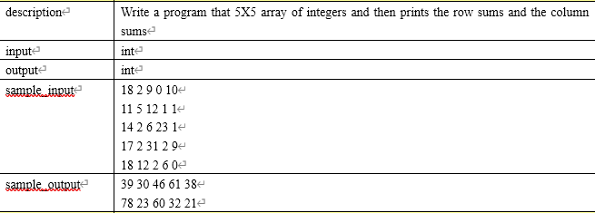
5X5 array
5X5 array
Notes:
Write a program input 5 by 5 array of integers and then prints the Sum of each row and the Sum of each column[ˈkɑːləm]

Slide 28
int grades[5][5];
int i,j,total;
// input the array
for (i = 0; i < 5; i++) {
for (j = 0; j < 5; j++)
scanf("%d", &grades[i][j]); }
for (i = 0; i < 5; i++) {
total = 0;
for (j = 0; j < 5; j++)
total += grades[i][j]; //row sum
printf("%d ", total); }
printf("\n");
for (j = 0; j < 5; j++) {
total = 0;
for (i = 0; i < 5; i++)
total += grades[i][j]; //colum sum
printf("%d ", total); }
Notes:
First, declare a 5 by 5 array, and Row and column Subscripts i, j to control a nested for loop. We also need a variable to store the sum.
Using a nested for loop to input the array.
To sum the elements of each row of the array, we write another nested for loop. In the outer loop, we increase the Row Subscript i from 0 to 4, in the loop body. First set total as 0 . Then we increase the column Subscript j from 0 to 4 in the inner loop. So we can enumerating ([ɪˈnuːməreɪtɪŋ]枚举) all the elements of every line and add them to total.
Use the same way we can get the sum of every column.
But In the outer loop, we increase the column Subscript jfrom 0 to 4, in the loop body. First set total as 0 . Then we increase the row Subscript i from 0 to 4 in the inner loop. So we can enumerating ([ɪˈnuːməreɪtɪŋ]枚举) all the elements of every column and add them to total.

Slide 29
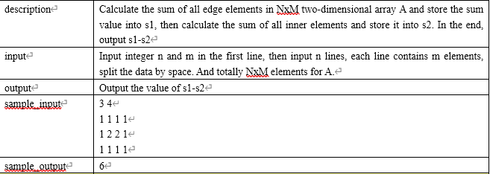
Edge and inner
Notes:
Edge [edʒ] and inner
Input a NxM two-dimensional array A ,calculate and output the Difference of the sum of edge elements and the sum of inner elements
//Input integer n and m in the first line, then input n lines, each line contains m elements, split the data by space. And totally NxM elements for A.

Slide 30
int n,m,i,j,s1=0,s2=0;
scanf("%d%d",&n,&m);
int a[n][m];
for(i=0;i<n;i++) for(j=0;j<m;j++) scanf("%d",&a[i][j]);
for(i=0;i<n;i++){
for(j=0;j<m;j++)
s1+=a[i][j];
} //sum of all
for(i=1;i<n-1;i++){
for(j=1;j<m-1;j++)
s2+=a[i][j]; //sum of inner
}
printf("%d\n",s1-s2-s2);
Notes:
Declare Row Subscript i, column Subscript j to control a nested for loop. We declare s1 and s2 and initialize them as 0.
we declare n,m and input them . Then we can use n and m declare a N BY M array.
Use a nested for loop to input the array.
we should calculate the Difference of the sum of edge elements minus the sum of inner elements . So we can calculate the sum of all the elements. Use a nested for loop to sum all elements of the array and store it in s1.
Use another nested for loop to sum inner elements of the array . to enumerating ([ɪˈnuːməreɪtɪŋ]枚举) all the inner elements , we must we increase the Row Subscript i from 1(not the beginning 0) to n-2, and we increase the column Subscript j from 1 to m-2. so we can sum inner elements of the array and store it in s2.
S1 is the sum of all the elements, s2 is the sum of the inner elements. So s1 minus s2 is the sum of the edge elements. Then minus s2 again ,we will get the Difference edge and inner

Slide 31
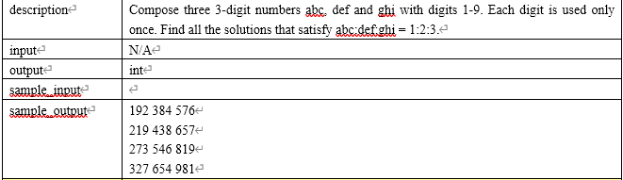
1:2:3
Notes:
Compose three 3-digit numbers abc, def and ghi with digits 1-9. Each digit is used only once.
The ratio [ˈreɪʃioʊ] of abc to def to ghi is 1 to 2 to 3
The ratio [ˈreɪʃioʊ] of these 3 numbers is 1 to 2 to 3
//Find all the solutions that satisfy abc:def:ghi = 1:2:3.

Slide 32
int i,j,p,num,n;
for(i=123;i<333;i++) {
int a[10]={0};
for(j=1;j<=3;j++) {
num=i*j; // i, 2*i, 3*i
while(num!=0){
n=num%10;
a[n]=1;
num=num/10; }
} //Separate and record
for(j=1;j<10;j++)
  if(a[j]!=1)break;
  if(j==10)
  printf("%d %d %d\n",i,i*2,i*3);
}
Notes:
We declare i as the first number. i is at least 123 and at most 333. for(i=123;i<333;i++)
We declare an array and and initialize all the elements as 0 . This array will help us record those used data. For example, if you use digit 2, assign elements a[2] as 1. if you use digit 3, set elements a[3] as 1. if you use digit n, set elements a[n] as 1.
Write a inner for loop to generate i, 2*i, 3*i and store it into number. Because The ratio [ˈreɪʃioʊ] of these 3 numbers is 1 to 2 to 3 , so they should be i, 2*i, 3*i
In the first iteration of the inner loop, j is 1, num is i*j which is 1 , so num is the first number. In the second iteration of the inner loop, j is 2, num is i*2 , so num is the second number. In the third iteration of the inner loop, j is 3, num is i*3 , so num is the third number.
Now we should Separate all the digits of those 3 numbers and record each with their corresponding element a[n] by using a while loop.
Use num%10 we can get the Rightmost digit of an integer. Put it into n and set it’s corresponding element a[n] as 1.
Use num/10 we can cut down the Rightmost digit of an integer.
Because divide a integer by 10 and you only keep the integer part of the quotient[ˈkwoʊʃnt]商. This is not rounding(不四舍五入).
for example, if you take 123 and divide it by 10, the quotient would be 12.3, and you take away the decimal so that only the integer part is left. 12 would be the final result of this expression.
Then a 3-digit number becomes a 2-digit number . So in the next iteration, the Rightmost digit we Separated is actually the middle one.
We can Separate the leftmost digit using the same way. Every time you Separate a digit you record each with their corresponding element a[n] by setting a[n] as 1.
After we we Separate all the 9 digits of those 3 numbers, we test the elements from a[1] to a[9]. Is we use all the digits from 1-9 , each for one time. There should be 9 ones in the array. If not , we break and do i++ to test nest number i. If yes. Output thoese 3 number i, 2*i, 3*i .

Slide 33
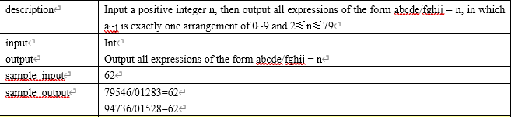
Division
Notes:
Division [dɪˈvɪʒn]
Input a positive integer n, then output all expressions of the form abcde/fghij = n, Each letter uses one number from 0 to 9. Every number is used only once. All numbers are used.

Slide 34
int n,i,t,m;
scanf("%d",&n);
for(i=1234;i*n<=98765;i++) {
int c[10]={0};
m=i;
do{
t=m%10;
c[t]=1;
m=m/10;
}while(m!=0); //Separate Divisor
if(i<=9999) c[0]=1; //use 0?
for(t=0;t<10;t++) m+=c[t];
if(m<5) continue;
else {
m=i*n;
if(m<=9999) continue;
else{
do{
t=m%10;
c[t]=1;
m=m/10;
}while(m!=0); //Separate dividend
for(t=0;t<10;t++)
m+=c[t];
if(m<10) continue;
else printf("%d/%05d=%d\n",i*n,i,n);
} } }
Notes:
We declare i as the Divisor [dɪˈvaɪzər]除数. We know the minimum value of i is 1234 but we don’t know the maximum value of i . However we know the maximum value of dividend [ˈdɪvɪdend]被除数 is98765 . We declare the quotient[ˈkwoʊʃnt]商 n . So it can be expressed as for(i=1234;i*n<=98765;i++)
We declare an array and initialize all the elements as 0 . We use this array to record those used digits. For example, if you use 2, assign elements c[2] as 1. if you use 3, set elements c[3] as 1. if you use digit t, set elements c[t] as 1. copy i to m.
Write a inner do while loop to separate all the digits of m and record each with their corresponding element c[t] .Use m%10 we can get the Rightmost digit of an integer. Put it into t and set it’s corresponding element c[t] as 1. Use m/10 we can cut down the Rightmost digit of an integer.
Because divide an integer by 10 and you only keep the integer part of the quotient[ˈkwoʊʃnt]商. This is not rounding(不四舍五入).
for example, if you take 1234 and divide it by 10, the quotient would be 123.4, and you take away the decimal so that only the integer part is left. 123 would be the final result of this expression. So in the next iteration, the Rightmost digit we Separated is actually Second digit from left.
We can Separate the rest digits using the same way. Every time you Separate a digit you record each with their corresponding element c[t] by setting c[t] as 1. After we Separate all the digits of the Divisor除数 i, we test if we used 0, by evaluate if i is a 4-digits integer. If true, setting c[0] as 1.
Now we test how many digits we have used in the Divisor除数 i. We add all the elements of the array, if the sum is less than 5 . we should skip the rest steps and do i++ to test next i. It can be expressed as if(m<5) continue; continue statement will skip the rest part of the loop body and begin the next iteration.
If we have used 5 different digits, then we can generate the dividend [ˈdɪvɪdend]被除数 m . m=i*n;
the dividend [ˈdɪvɪdend]被除数 m should be greater than 9999, if not, skip the rest statement and continue next iteration. If yes, we separate the dividend. [ˈdɪvɪdend]被除数 m and record each used digits .
Finally we add all the elements from c[0] to c[9]. If we use 0-9 each digit one time, there should be 10 ones. The sum should be 10. If the sum is less than 10, continue. Else output the Divisor and the dividend .

